Slide 1


3-Phase Matrix Converter Chase Barnes
Daniel Loeza
Shanelle Algama
Sponsor: Dr. John Lusher

Slide 2
Problem Overview
Traditional Variable Frequency Drives utilizes AC-DC-AC conversion:
decreases efficiency across power output, and increases harmonic distortion.
3 Phase Matrix Converter utilizes AC-AC conversion:
reduces efficiency loss across components.
Notes:
Summary of your problem being solved and high level summary of your solution.
Include block diagram with subsystems and owners

Slide 3
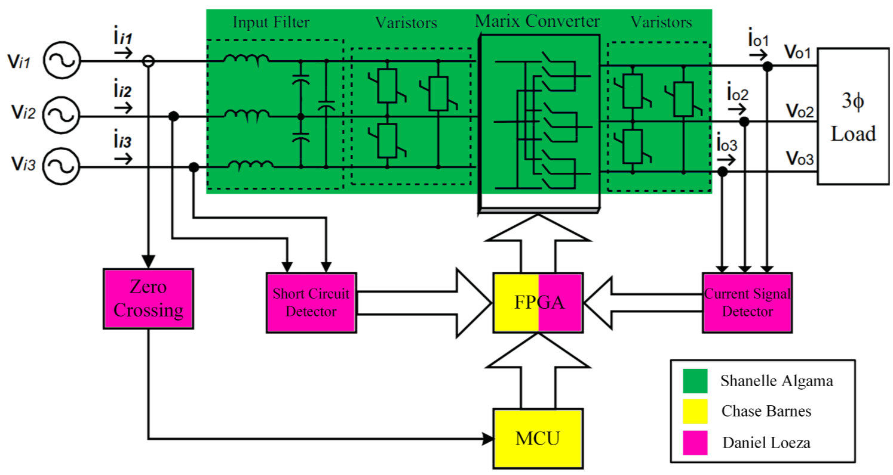
System Overview
Notes:
We NEED TO CHANGE THIS

Slide 4
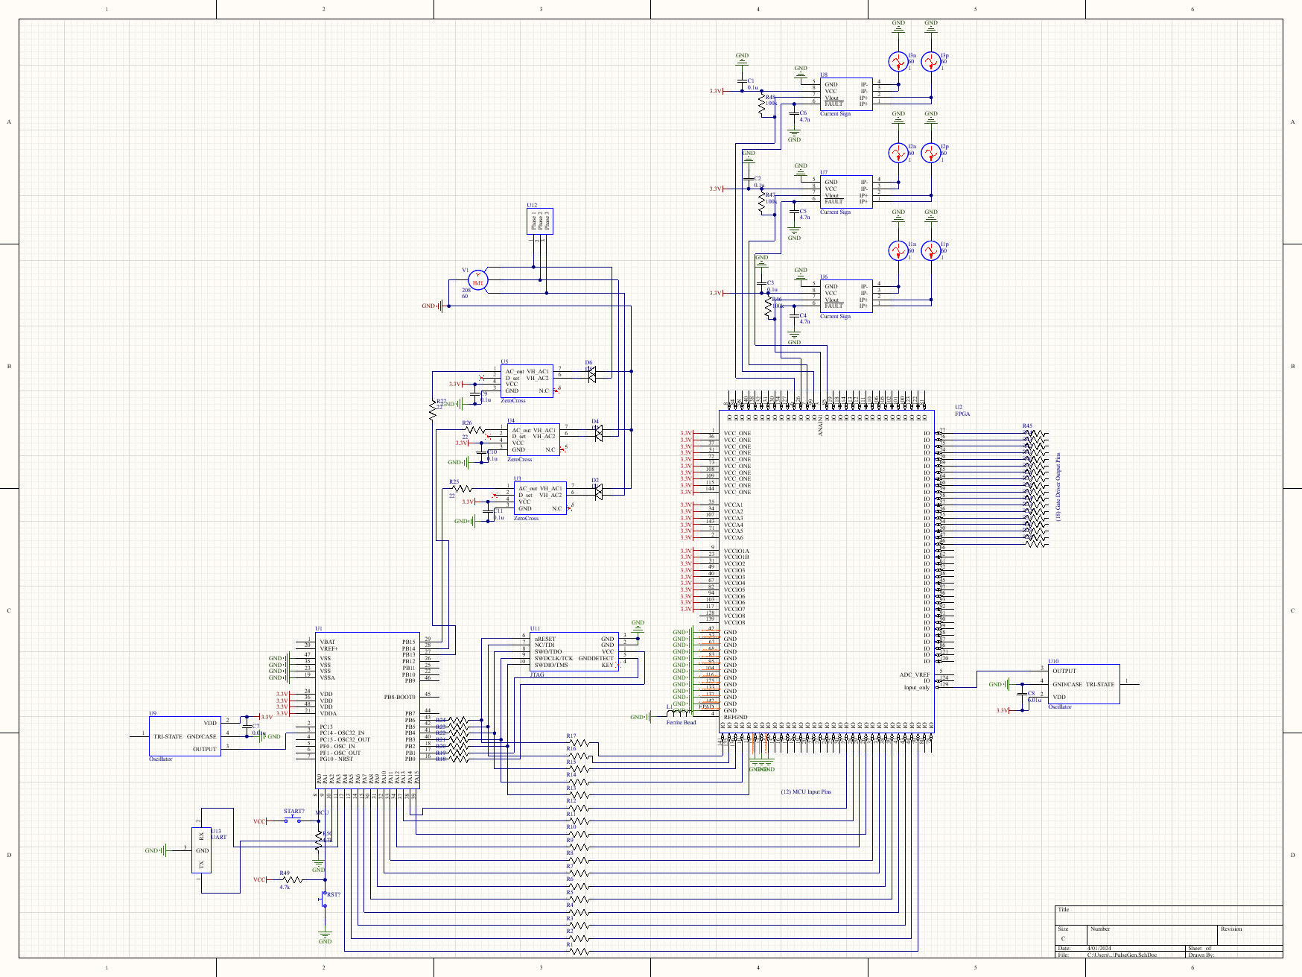
Pulse Generator Design Accomplishments
Part Selection & Pulse Generator Schematic - ~15 Hours

Slide 5
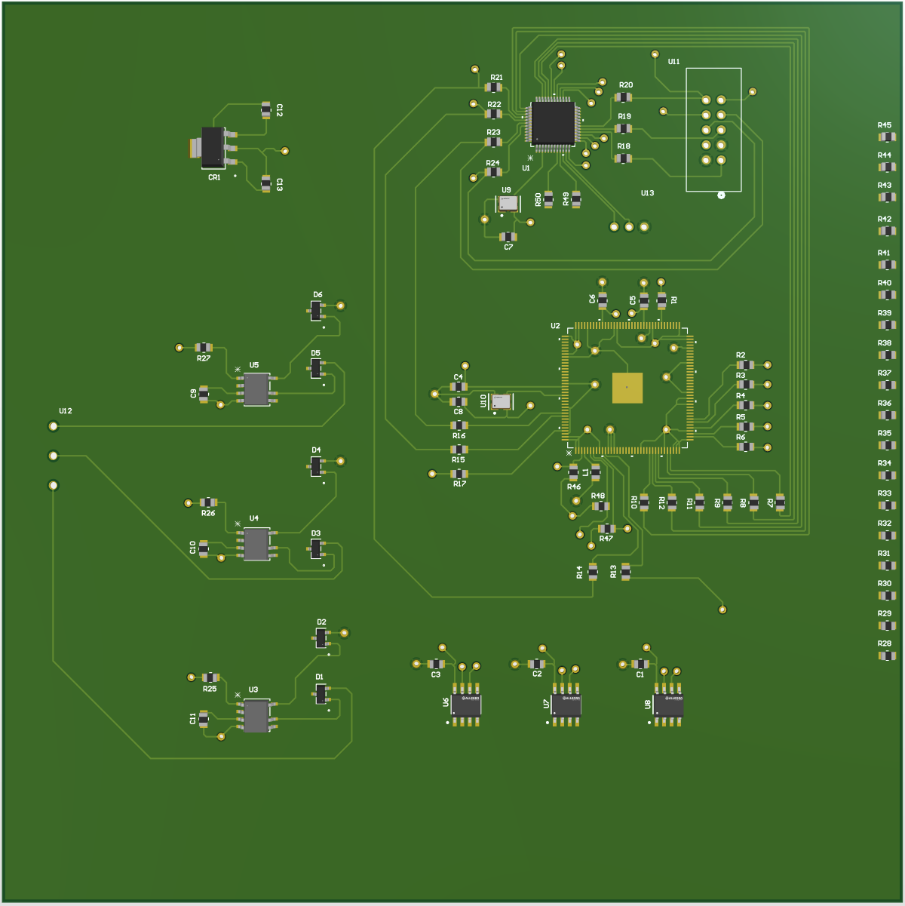
Pulse Generator Design Accomplishments
Pulse Generator PCB - ~45 Hours

Slide 6
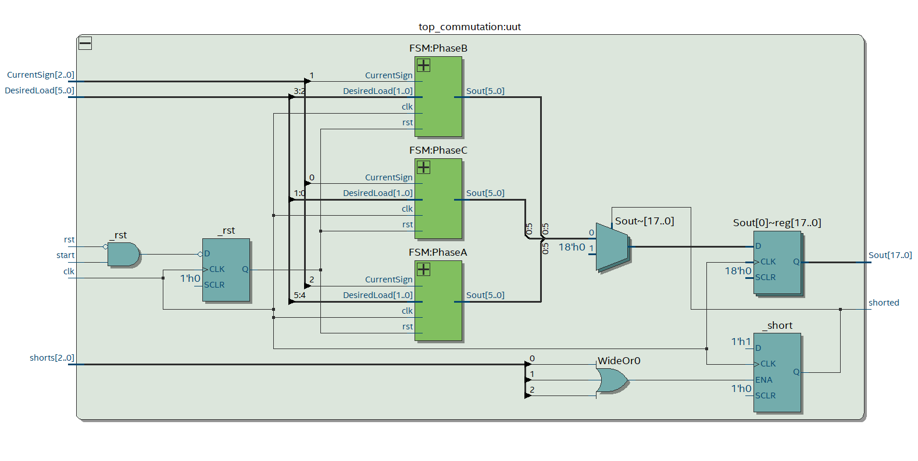
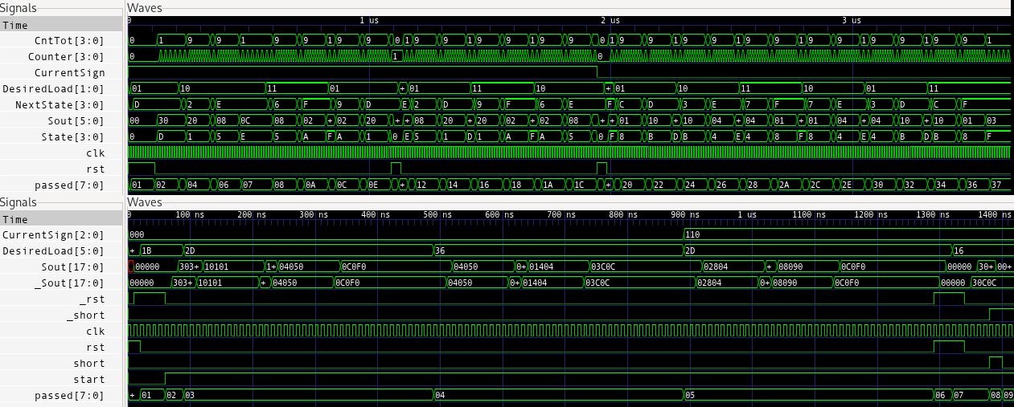
MCU and FPGA Design Accomplishments
FPGA:
System is functioning on Dev Board
Validation for it will be completed tonight.
Notes:
Overview of what has been designed, tested, and validated for each subsystem for the project. (this is NOT a progress update, but rather a summary of what you have accomplished in 403) Show data collected and measured and/or simulated results (2 slides per subsystem)
Try to avoid screens of code
Save demo material for your project demo (video captures, storyboards, bench test pictures, etc)

Slide 7
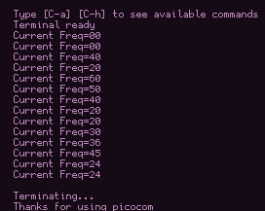
MCU and FPGA Design Accomplishments
MCU and SVM:
Dev environment has been set up
SVM algorithm is still in development and validation.
UART Communication Functional
Notes:
Overview of what has been designed, tested, and validated for each subsystem for the project. (this is NOT a progress update, but rather a summary of what you have accomplished in 403) Show data collected and measured and/or simulated results (2 slides per subsystem)
Try to avoid screens of code
Save demo material for your project demo (video captures, storyboards, bench test pictures, etc)

Slide 8
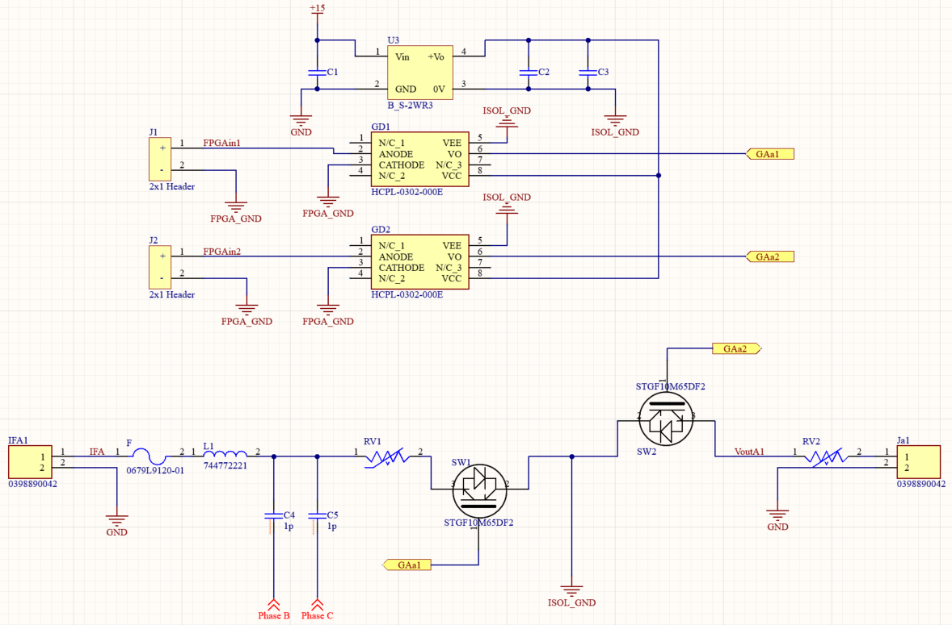
Matrix Converter Design Accomplishments

Slide 9
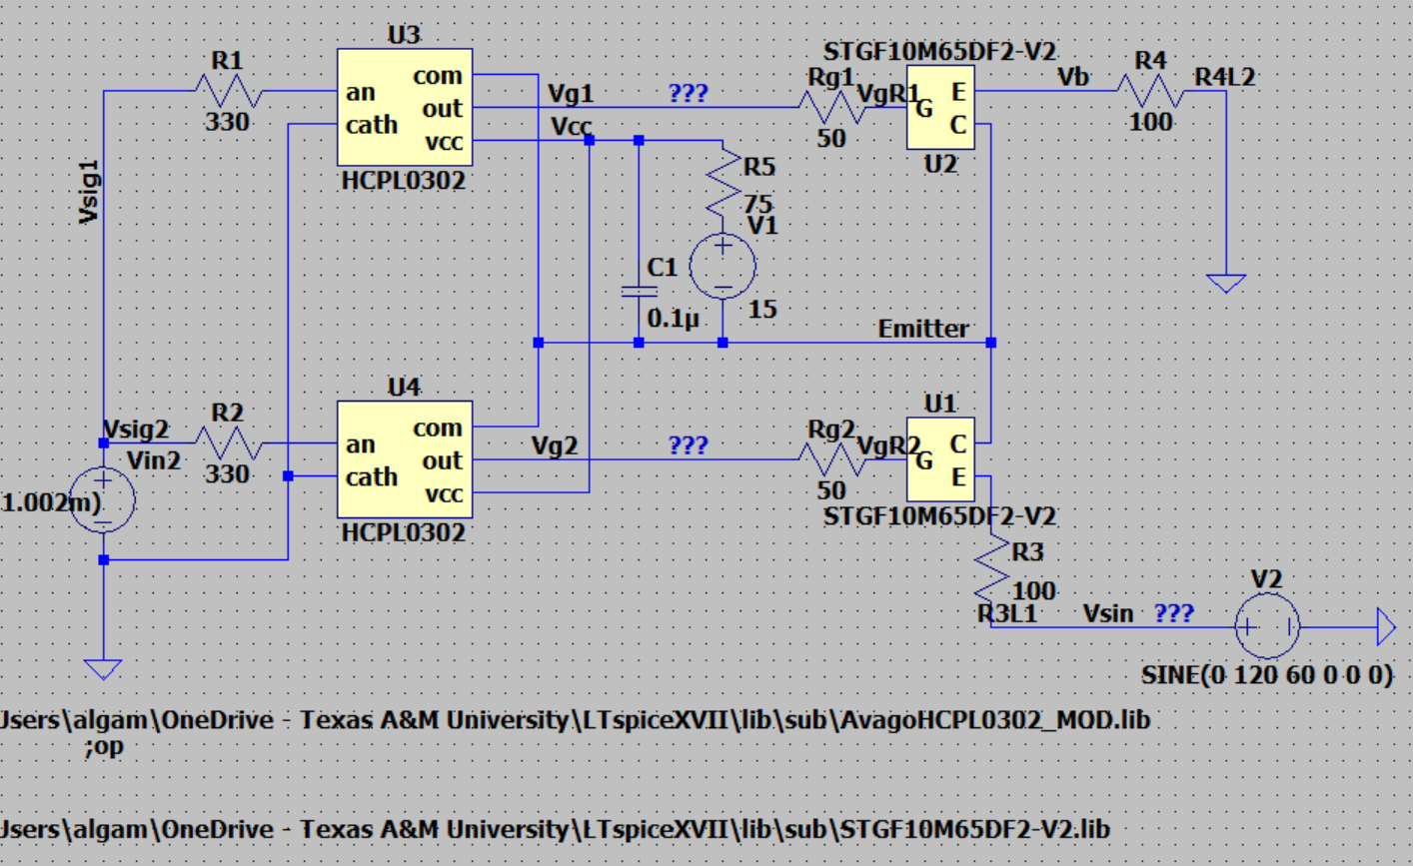
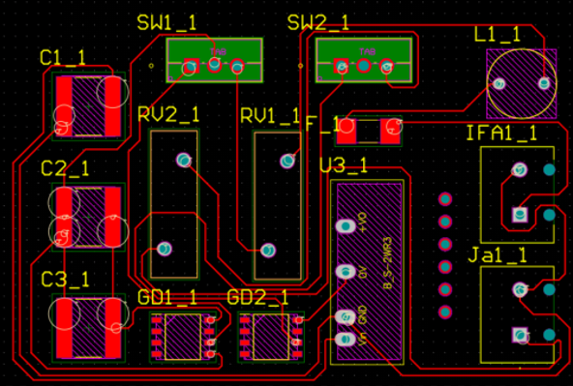
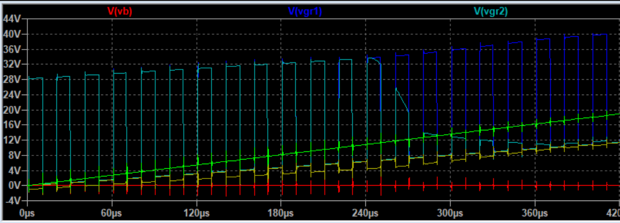
Matrix Converter Design Accomplishments
Spent a lot of time dealing with simulation failures and was unable to test in FEDC but currently working on PCB.
PCB will be completed by today, simulations and testing will be conducted after

Slide 10
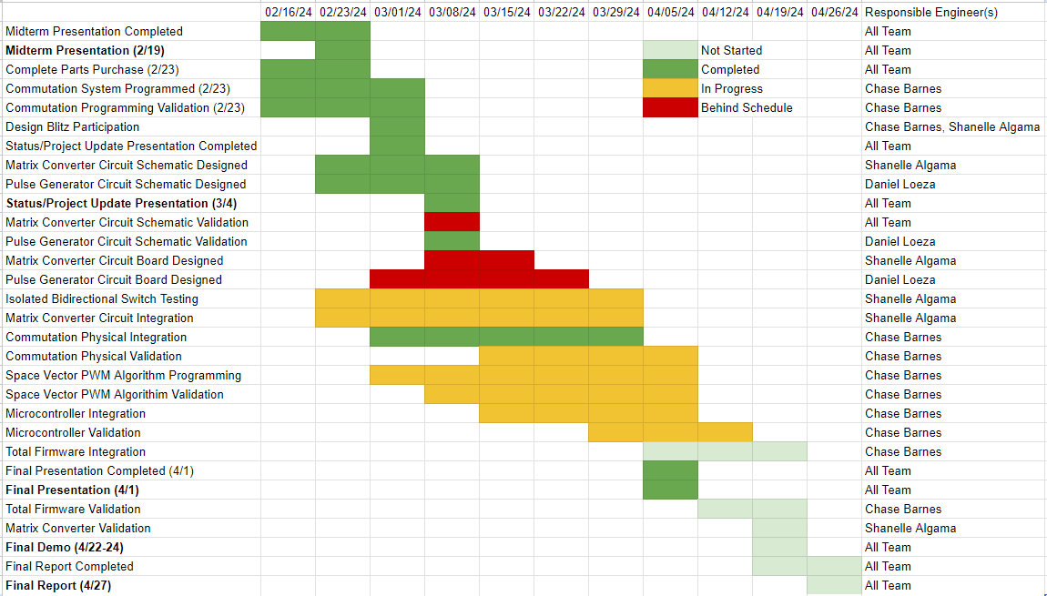
Execution and Validation Status

Slide 11
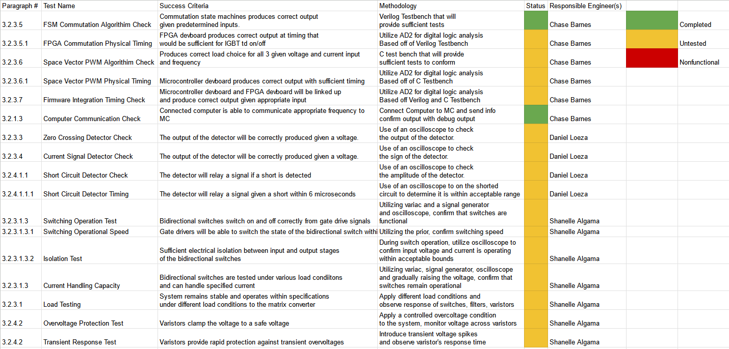
Execution and Validation Status

Slide 12
Remaining Tasks
403 Tasks:
Complete, order, and assemble PCBs for the Pulse Generator and Matrix Converter subsystems.
Complete the validation of all subsystems
404 Tasks:
Integration of Final Product
Calibration of Sensors
Notes:
Summarize what remains to be completed for subsystem design, assembly, test, validation by Project Demo date
Summarize what key design activity from each subsystem will be completed in 404 (eg. fabrication and assembly of final PCB, full ML model training, in-situ sensor calibration, enclosure design and fabrication, mount 3d-printing)

